Slide 1
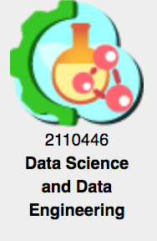
Module2 ML’s Overview 2110446: Data Science and Data Engineering
Peerapon Vateekul, Ph.D.
Department of Computer Engineering,
Faculty of Engineering, Chulalongkorn University
Peerapon.v@chula.ac.th

Slide 2
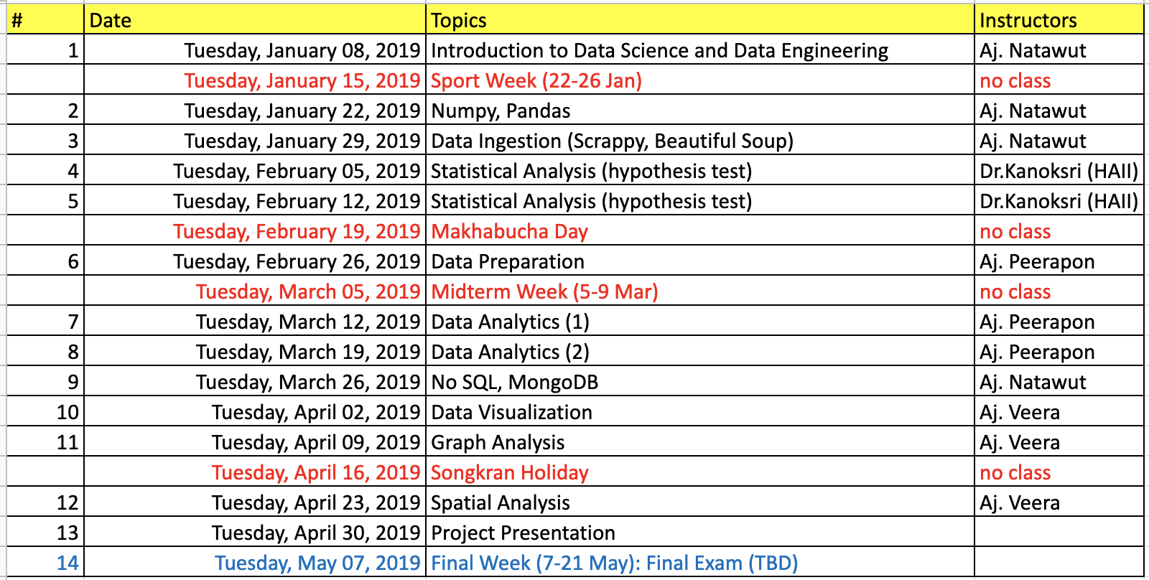
Updated Tentative Schedule

Slide 3
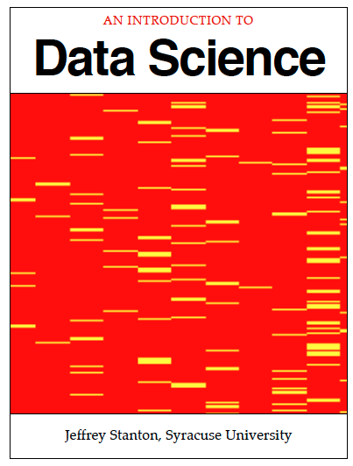
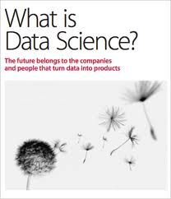



What is Data Science?
Data
Facts and statistics collected together for reference or analysis
Science
A systematic study through observation and experiment
Data Science
The scientific exploration of data to extract meaning or insight
, and the construction of software to utilize such insight in a business context.
Data Preparation
Data Analysis
Data Visualization
Data Product
Chula Data Science

Slide 4


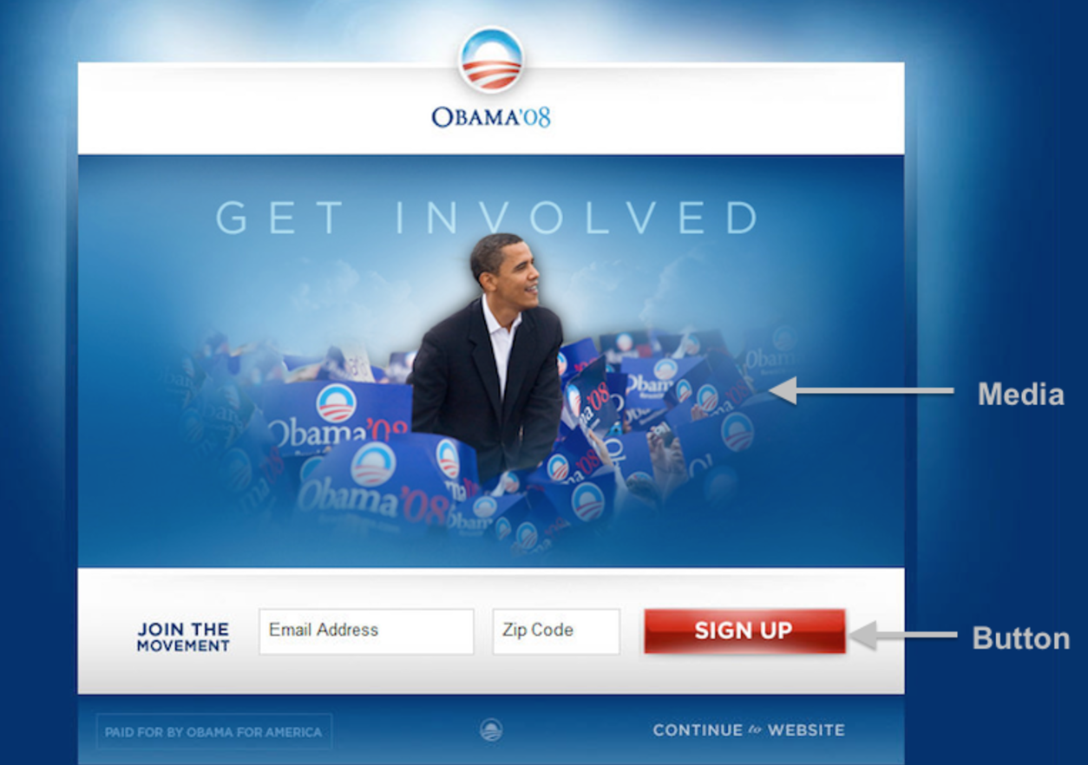

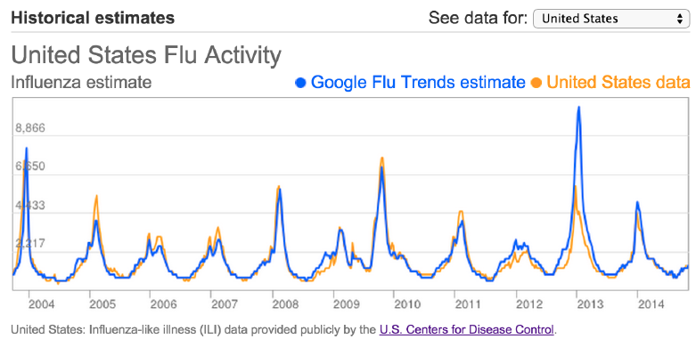
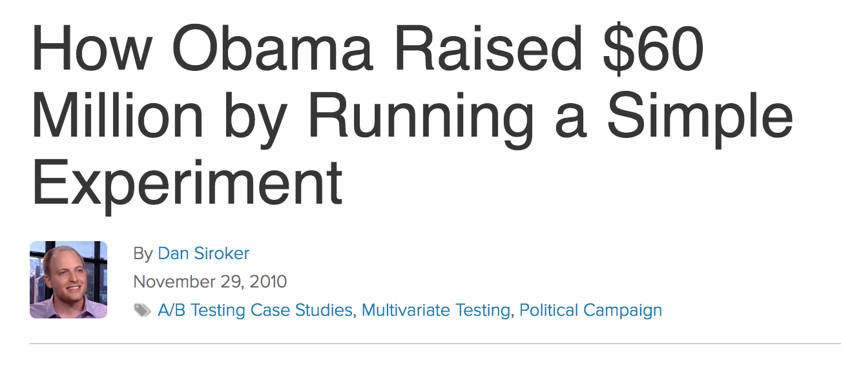
What is Data Science? (cont.)
Code Mania 2, Jan-2015
2
Transform data into valuable insights
Transform data into data products
Transform data into interesting stories
1
3

Slide 5
What is Data Science? (cont.)
Code Mania 2, Jan-2015
Data Visualization
Data Analysis
Statistical Analysis
Data Engineering
3
Transform data into valuable insights
Transform data into data products
Transform data into interesting stories
2
1

Slide 6

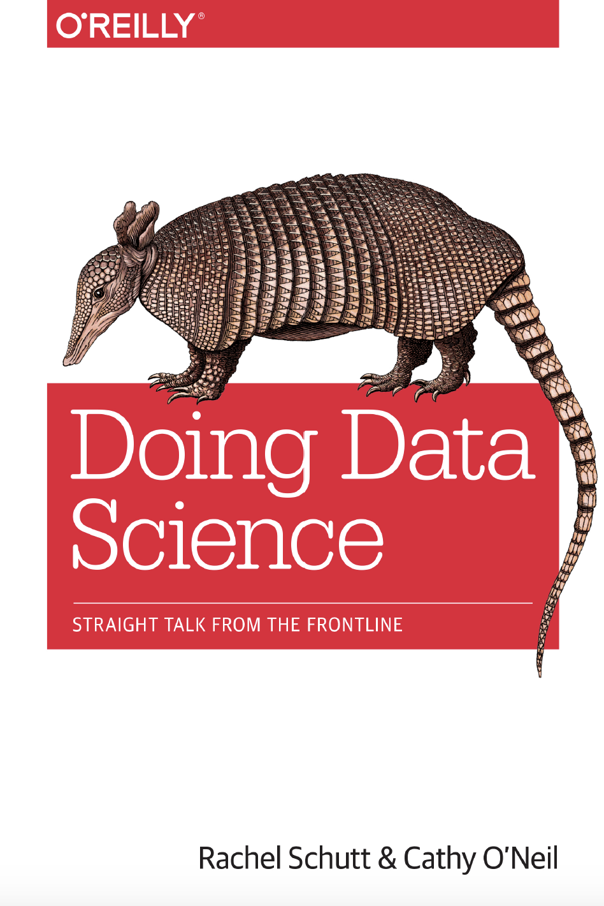
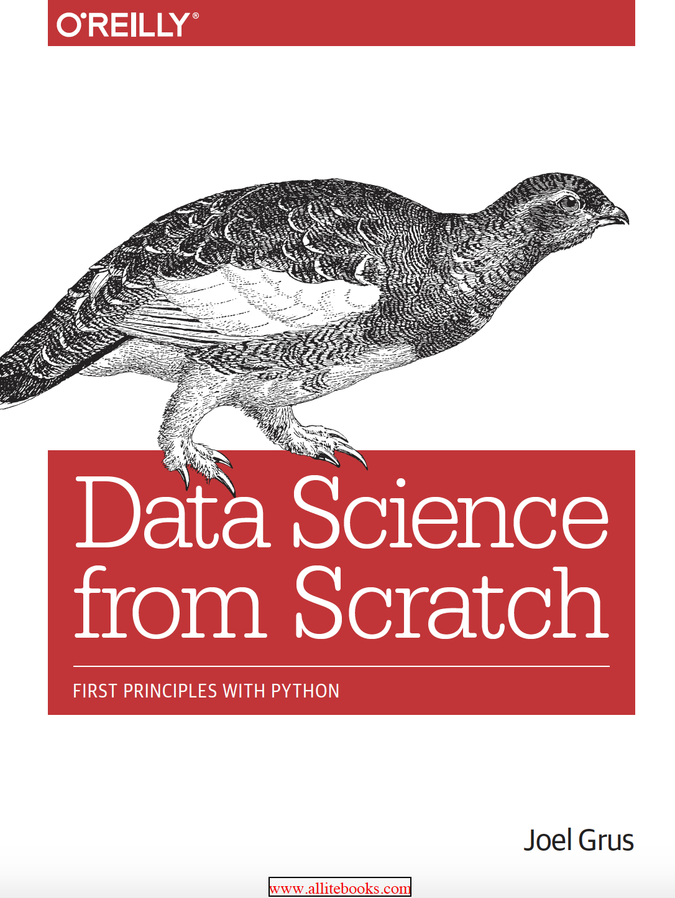

Data Science Book

Slide 7
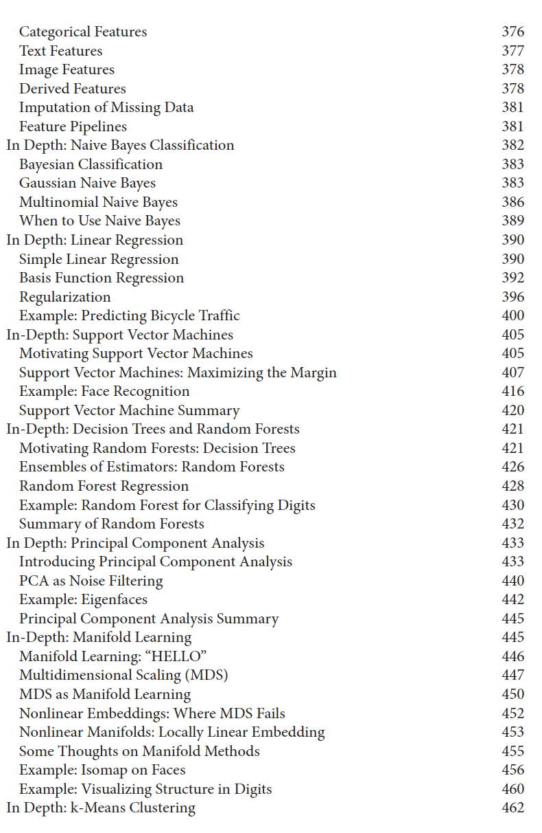
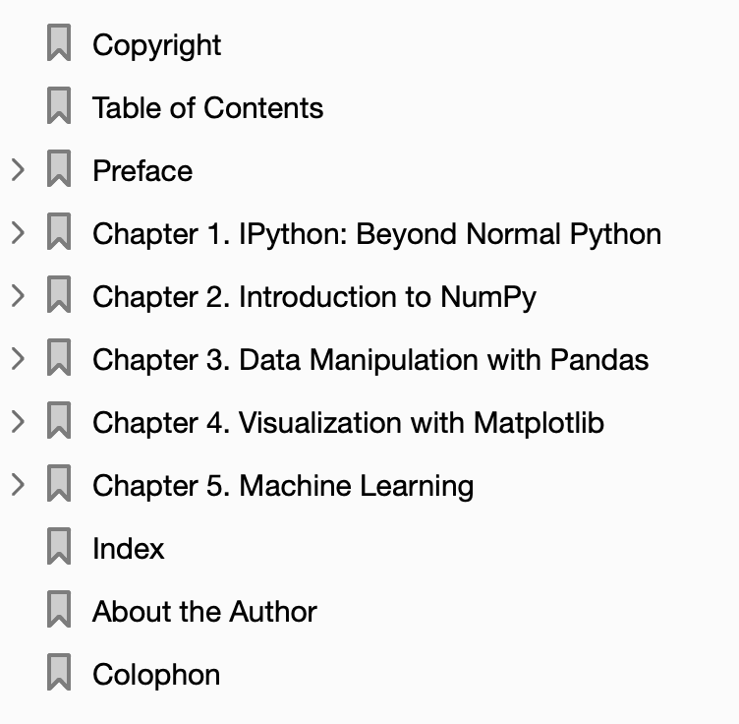
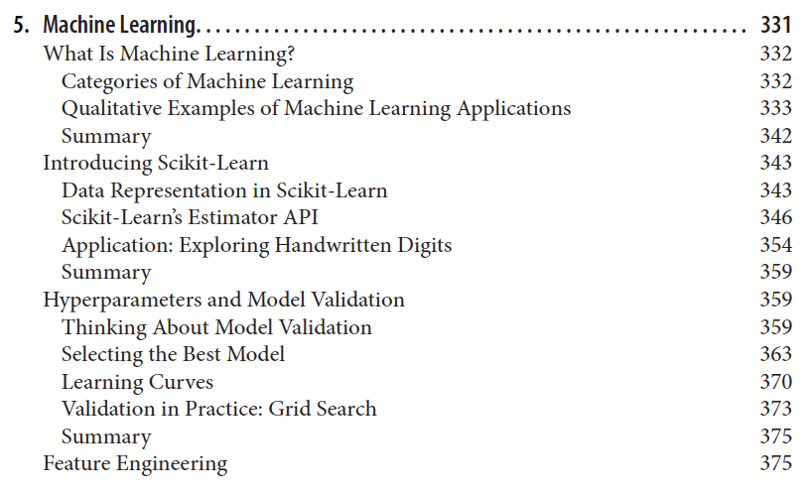
2016-11-17

Slide 8
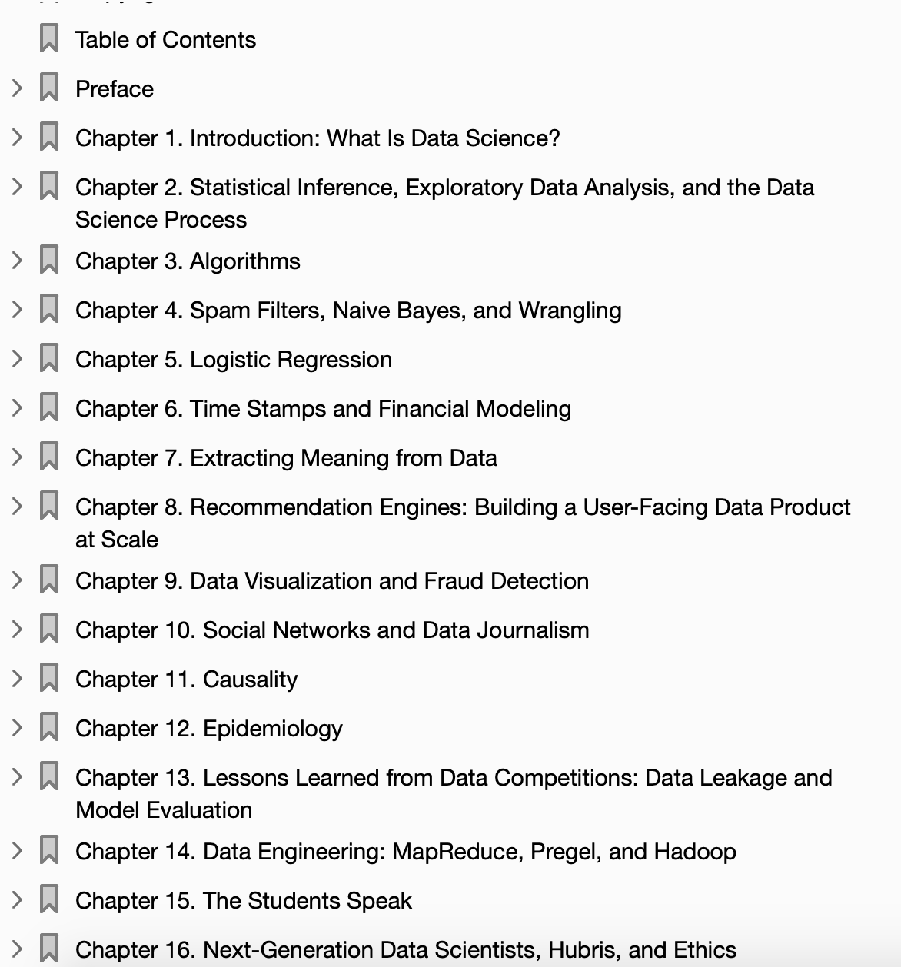
2013-10-08

Slide 9
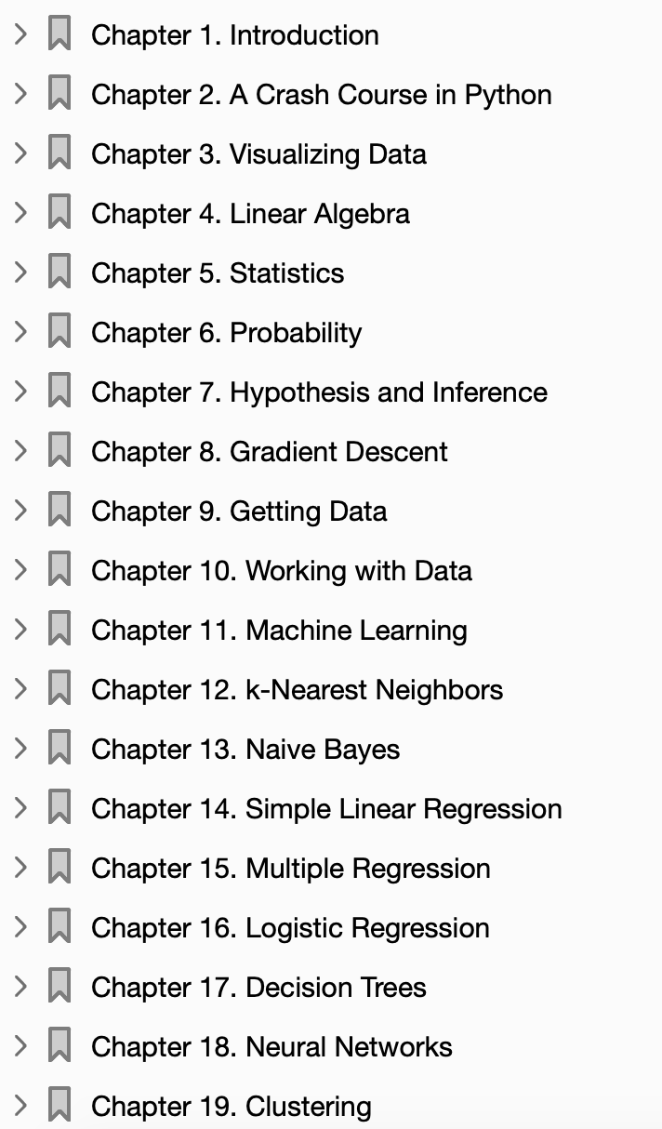
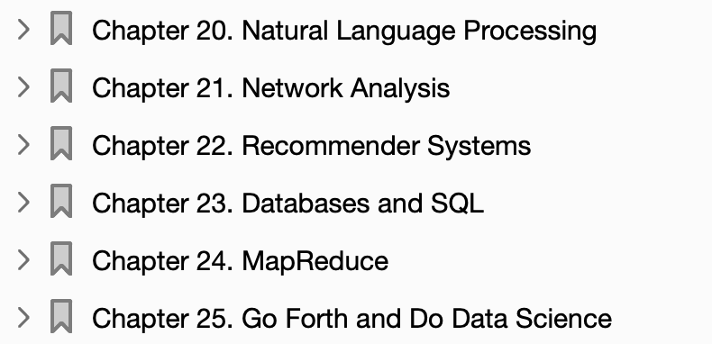
2015-04-10

Slide 10
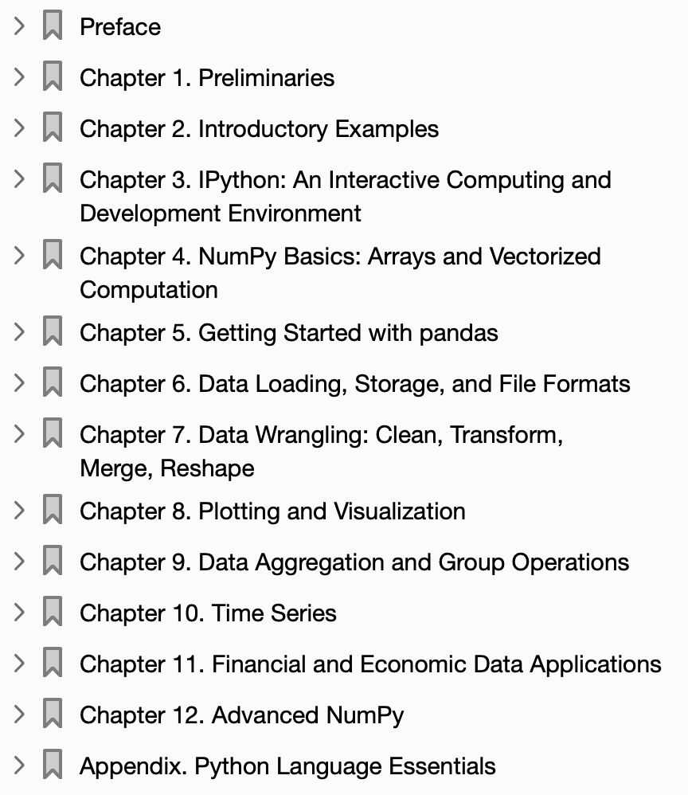
2012-10-05

Slide 11

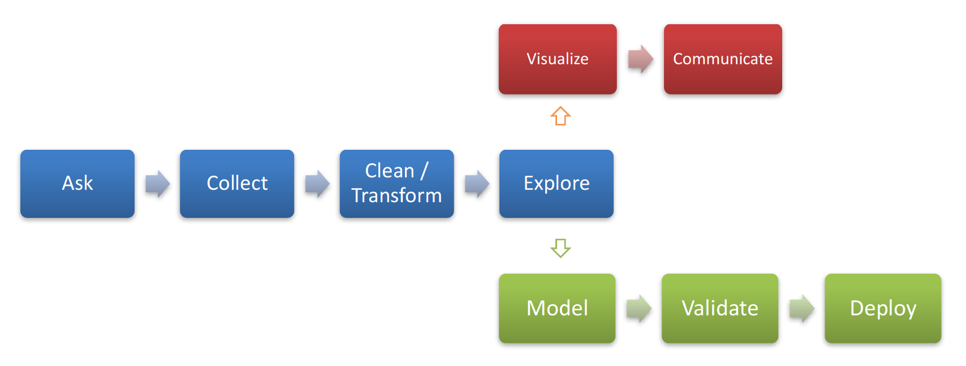
Previous class
Be able to explore data
Be able to identify issues in data
But do NOT process data yet
Cleansing & pre-processing
Data Science Process

Slide 12
Module’s Objective
Be able to validate & correct data issues, e.g., missing value, skewness, etc.
Understand machine learning (ML) techniques along with important parameters
Supervised Learning
Unsupervised Learning
Not include every ML techniques, and focus on data analytical techniques, e.g., not include reinforcement learning (RL)
Not include mathematical proof
Be able to choose proper machine learning (ML) techniques
Be able to apply ML and evaluate performance using Python

Slide 13
Topics in 3 weeks!
Data preparation
Introduction to ML
Supervised Learning
Decision Tree & its variation
Regression
Neural Networks
kNN
Unsupervised Learning
K-means
Association Rule Mining
Reinforcement learning (overview)
Recommendation System
Collaborative Filtering
Time Series Analysis
Deep Learning
CNN
LSTM

